Slide 1



CELONIS CAPSTONE PROJECT

Slide 2
01
PROBLEM STATEMENTS OF COMPANY-X
02
ORDER ANALYSIS
03
FULFILMENT ACTIVITIES AND CASES
04
ACCOUNTS PAYABLE
05
04
PREPAID TRAVEL COST
TABLE OF CONTENTS
06
PAYMENT REQUEST
07
CONCLUSION

Slide 3
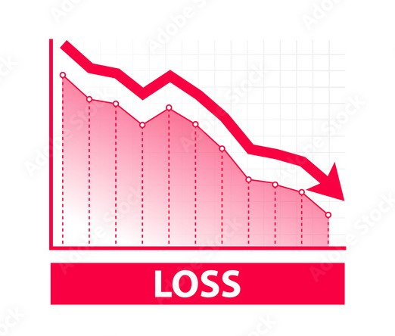
OVERVIEW (COMPANY-X)
01
PROFIT MARGIN DECLINE
02
LOW AUTOMATION RATE
03
UNDERPERFORMANCE IN SEA MARKET
04
INEFFICIENT FINANCIAL PROCESS
05
UNIDENTIFIED PROJECTS

Slide 4
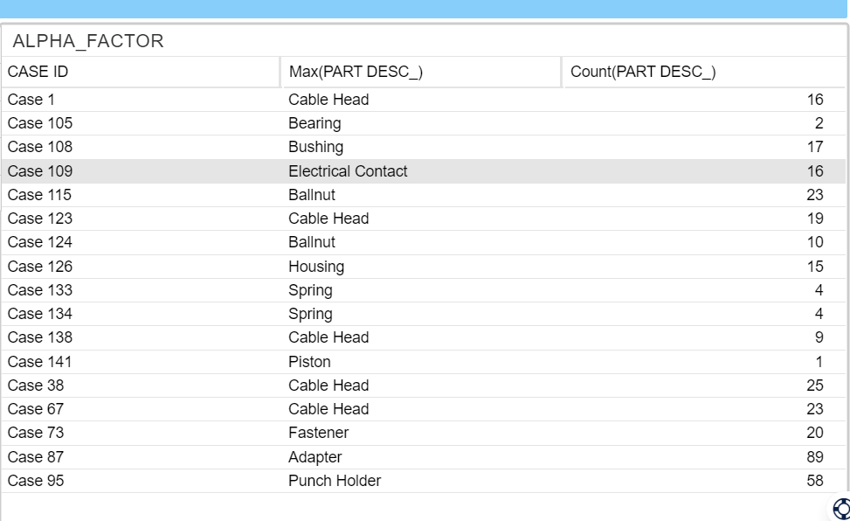
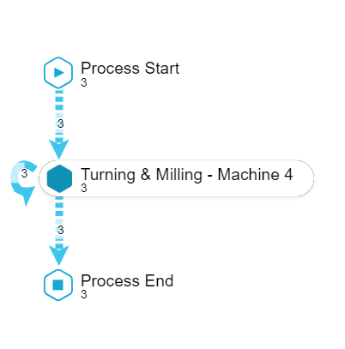
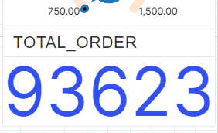
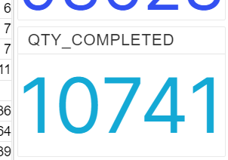
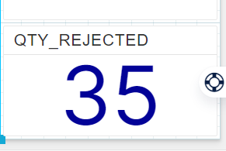
ORDER ANALYSIS

Slide 5
FOCUS TURNING AND MILING MACHINE-4
GROUPING OF SIMILAR WORKS
WORKER EFFICIENCY IS LESS
REJECTION RATE IS APPROX 1%

Slide 6
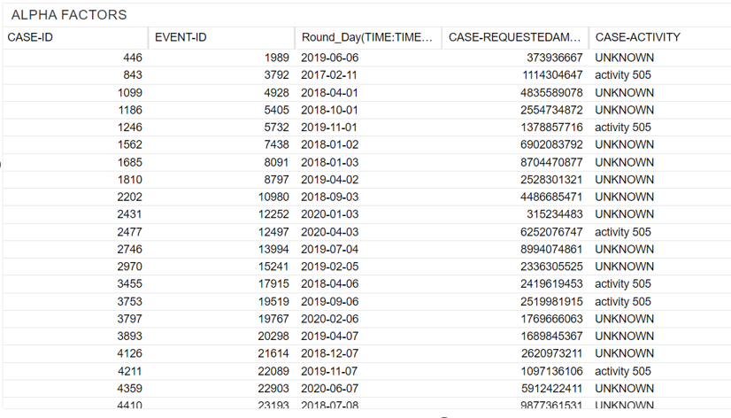
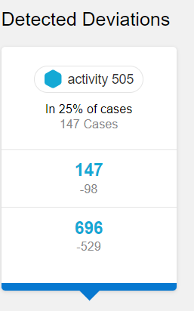
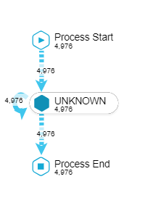
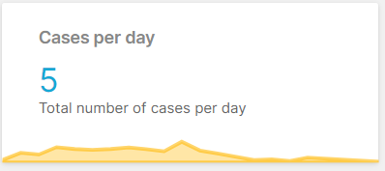
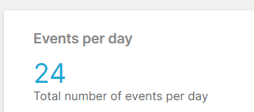
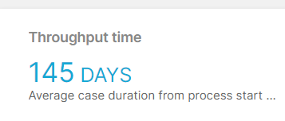
PAYMENT REQUEST

Slide 7
COMMON EVENTS IN REQUESTED AMOUNT
DATA INCONSISTENCY
REQUESTED AMOUNT VS BUDJET
PATTERN IN PAYMENT

Slide 8
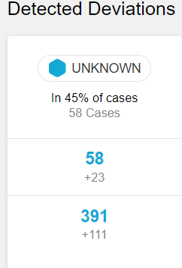
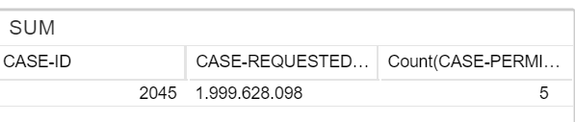
PREPAID TRAVEL COST

Slide 9
DEVIATION CONTROL
TRAVEL TYPE ANALYSIS
PATTERN OF SIMILAR ACTIVITIES
HANDELING UNEXPECTED REQUESTED AMOUNT

Slide 10
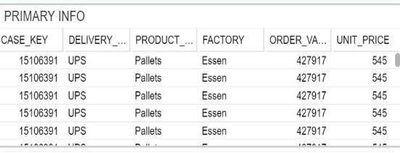
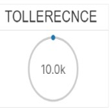
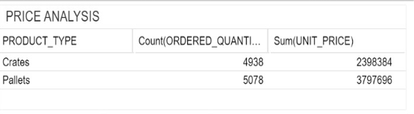
FULFILMENT ACTIVITIES AND CASES

Slide 11
PRODUCT ARRANGEMENT
QUALITY CONTROL
TOLLERENCE
QUANTITY ISSUES

Slide 12
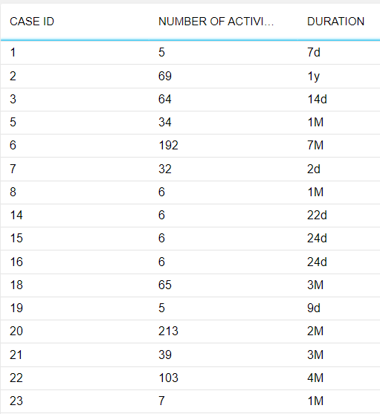
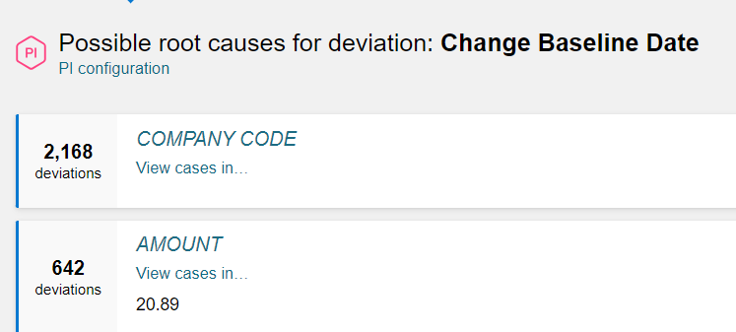
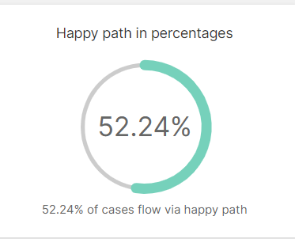
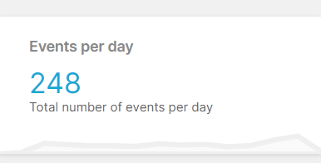
ACCOUNTS PAYABLE

Slide 13
GROUPING OF SIMILAR TIME STAMP
DIVERSIFICATION OF DATA
DEVIATIONS SHOULD BE HANDLE
LACK OF INTEGRITY

Slide 14
CONCLUSION
PROCESS AUTOMATION
PERFORMANCE ASSESMENT
FOCUS ON SEA MARKET
EFFICIENT WORK
PROJECT EVOLUTION
COLLABORATION

Slide 15
Should company X start with looking at individual employee performance ?
How efficient SEA processes compared to Europe?
Automation is low across all processes. Which areas can be quick wins or alternatively, where long term investments could yield big results ?

Slide 16
Are there too many cooks in the kitchen with approval processes. If so, who might be the easiest to ‘cut’ from the standard approval processes ?
Which vendors can we rely on for expansion ? Any outliers who are under and overperforming . And how can we work with them on globalization
Company X hopes to grow somewhere between 18-22% YOY. How might the increase in orders, purchasing, travel cut into profits, or increase profits over the next 5 years?

Slide 17
THANK YOU
Submitted By: V.Naveen

